Slide 1

Ideas for Decorating
Bulletin boards in schools

Slide 2


Slide 3
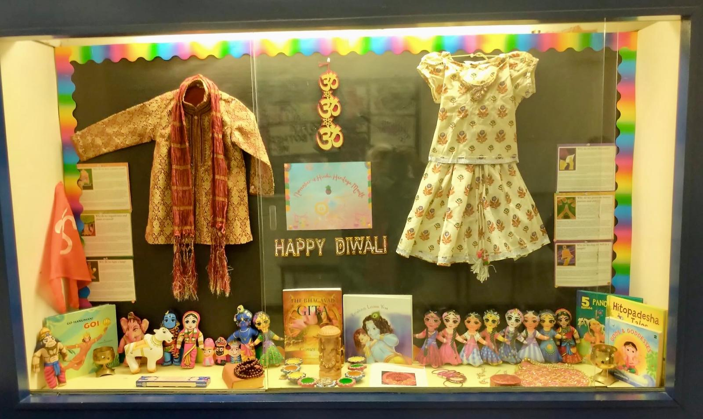

Slide 4
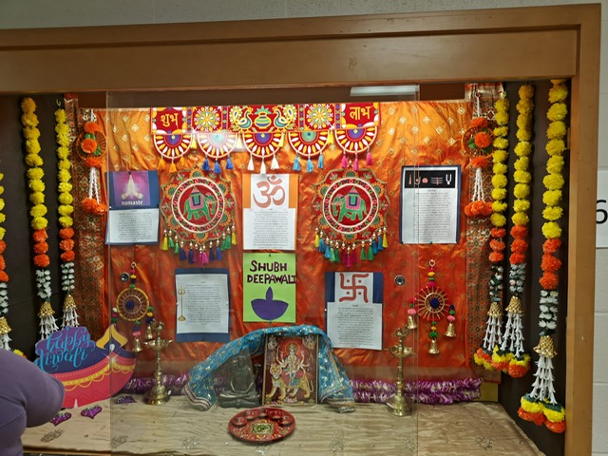

Slide 5
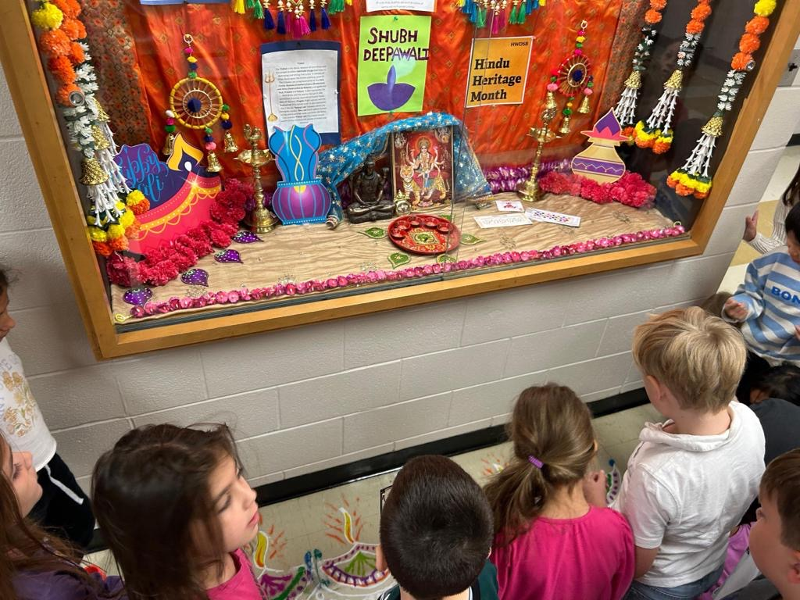

Slide 6
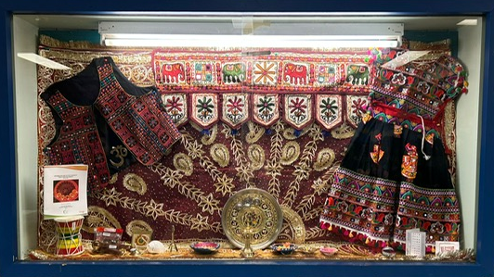

Slide 7
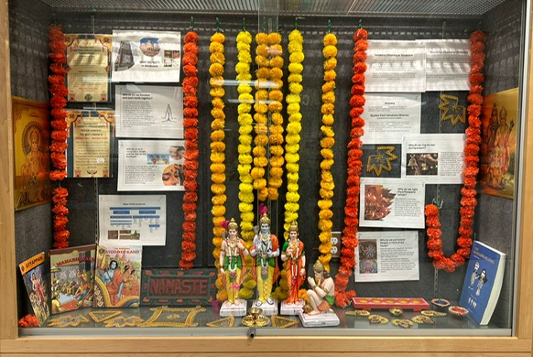

Slide 8


Slide 9
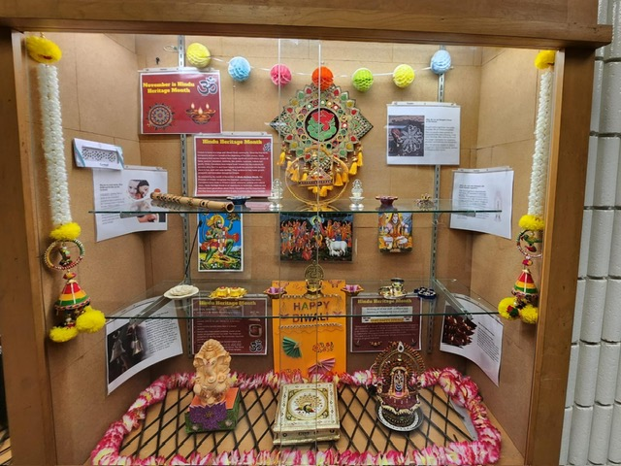

Slide 10

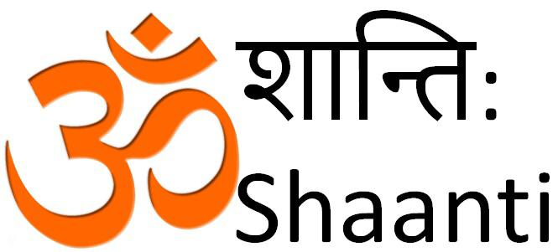
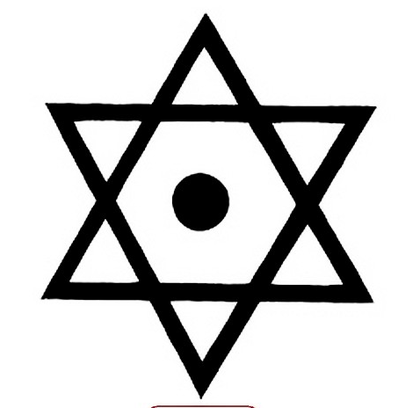
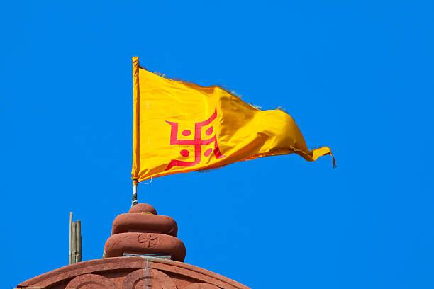
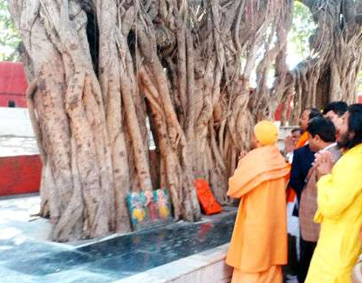

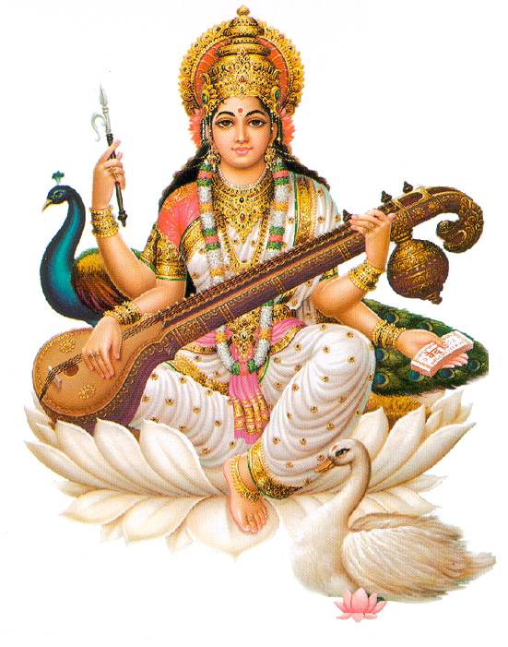

Hindu symbols
AUM or OM
Mantra: A sacred sound
The Sound of the universe
Shatkona
Interlocking Male & female
cosmic energies
Swastika
Wellbeing And
Auspiciousness
A Tilak, worn on Forehead,
signifies spiritual third eye
Banyan tree
Oneness of Sanatana Dharma
Namaste
The divine in me
bows to the divine in you
Lotus
Purity, beauty
and detachment
Sarasvati Devi Goddess of art and knowledge
Notes:
Hindus are currently facing increasing levels of prejudice, hate and discrimination in schools, workplaces, media, academia and in public at large. At the same time, there is a huge lack of understanding or acknowledgement of Hinduphobia in all these spheres as a result of which the problem remains unaddressed.

Slide 11
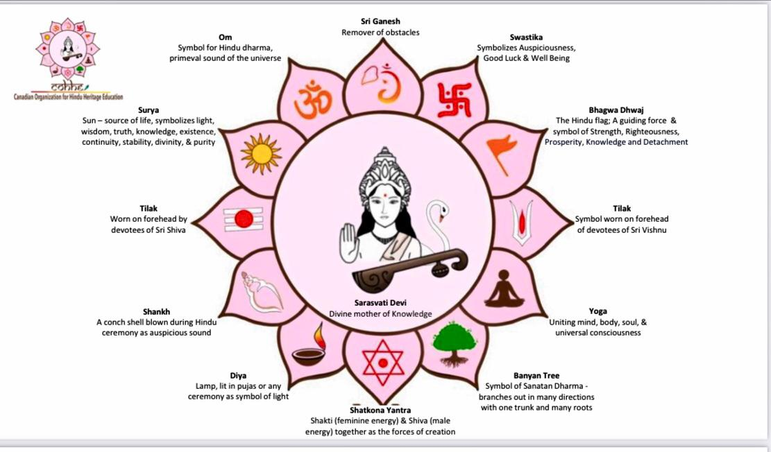

Slide 12


Slide 13
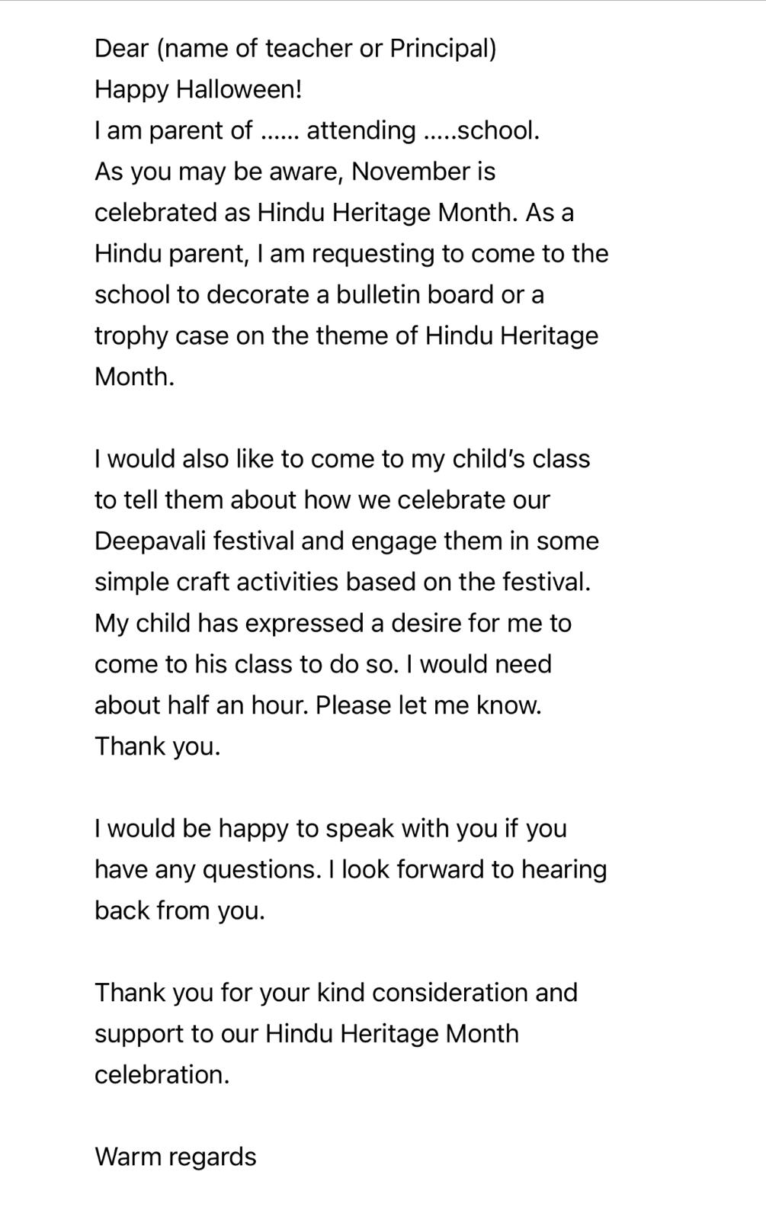
Draft letter to teacher or principal asking to decorate the bulletin board at school.

